Slide 1
UNIT 6

Slide 2
Linear Regression
Intuition for Linear Regression

Slide 3
Tips for Service
Tip is very part of waiters pay .
Most of the time it is related to bill amount .
As a owner , you would like to develop a model that will allow prediction about the amount of tip to expect for a given bill amount .
You collect data for 6 meals (random sample)

Slide 4
Tip of service
Meal | Tip
1 | 5
2 | 17
3 | 11
4 | 8
5 | 14
6 | 5
When you begin to look at data you realize that you collected
Only tip amount not the bill amount
How might you predict the tip amount for future meal using This data?
Tip for mean no 7 ??

Slide 5
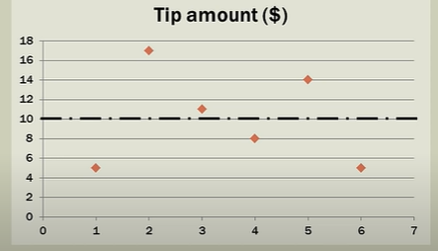
Tip of service
Mean for 6 tips is 10.
With only one variable and no other the best prediction for the next measurement is the mean of the sample.
The Variability in the tip amount can be explained by the tip themselves

Slide 6
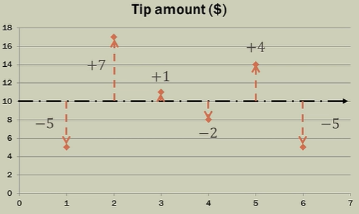
Goodness of fit
Data point do not fall on line .
Measure the distance from best fit line(std devation).
i.e distance from mean .
Distance is called Error or residual .
Observed value from best fit line
Sum of error is Zero.

Slide 7
Squaring the residual
Meal | Residual | Residual 2
1 | -5 | 25
2 | 7 | 49
3 | 1 | 1
4 | -2 | 4
5 | 4 | 16
6 | -5 | 25
Sum of square of error = 120
Why square residual?
Make them positive
Emphasizes on larger deviation

Slide 8
Sum of square
The goal of simple linear regression is to create a linear model that minimizes the sum of square of the error/residuals
We want to create a different line through the data once we introduce a independent variable that will minimize the size of square and that will be the best fit line for the data.
But in this problem we use only one variable (dependent variable)
We have independent variable it will create a different best fit line through the data
And will reduce error .
Regression line should fir the data better and minimize error

Slide 9
Regression Analysis
Regression analysis is the method of predicting or estimating one variable knowing the value of another variable
Estimation is required in different fields
Regression analysis develops an equation or formula between the related variable
If the equation is established between the variable it helps in predicting controlling and planning the activities

Slide 10
Simple regression
Simple regression is a part of bivariate statistics (two variable)
Co-relation and anova -→ simple regression
The value of one variable is a function of the other variable
Value of y is function of x; y = f(x)
Value of dependent variable is a function of independent variable

Slide 11
Tip for sevice
Working with 2 variables
Dependent variable : tip
Independent variable : total bill
Total Bill | Tip
34 | 5
108 | 17
64 | 11
88 | 8
99 | 14
51 | 5

Slide 12
When the slope is equal to zero , m=0
In this situation y is 10 for every value of x
Y=mx+c (m=o)(c=10, mean)
Y=(0*x)+ c
Y=c

Slide 13
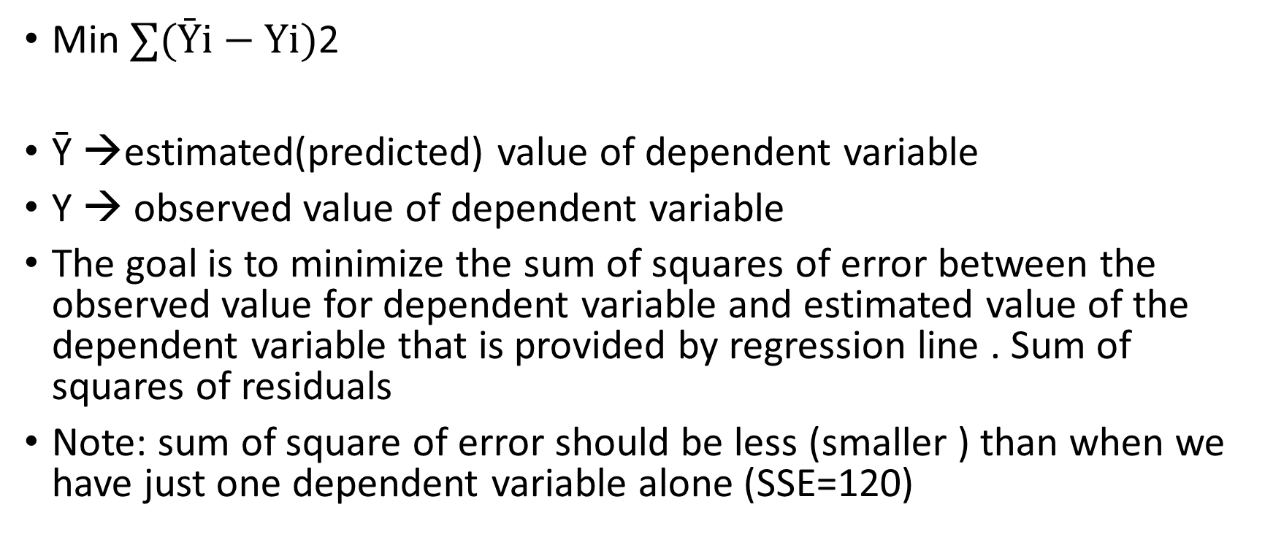
Least square criterion
Min $∑(Ȳi−Yi)$2
Ȳ →estimated(predicted) value of dependent variable
Y → observed value of dependent variable
The goal is to minimize the sum of squares of error between the observed value for dependent variable and estimated value of the dependent variable that is provided by regression line . Sum of squares of residuals
Note: sum of square of error should be less (smaller ) than when we have just one dependent variable alone (SSE=120)

Slide 14
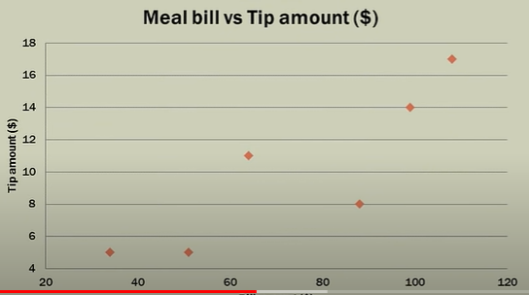
Step 1 : Scatter Plot
Total Bill | Tip
34 | 5
108 | 17
64 | 11
88 | 8
99 | 14
51 | 5

Slide 15
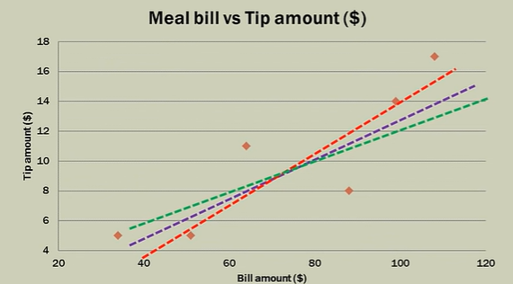
Step 2: look for a visual line
Does the data seem
To fall along the line?

Slide 16
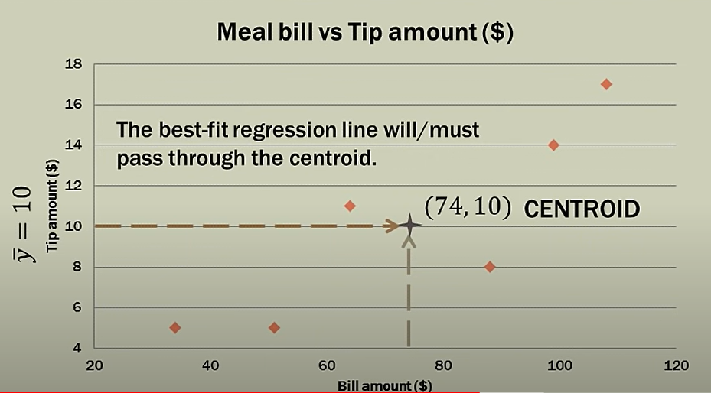
Step 3: Descriptive Statistics

Slide 17
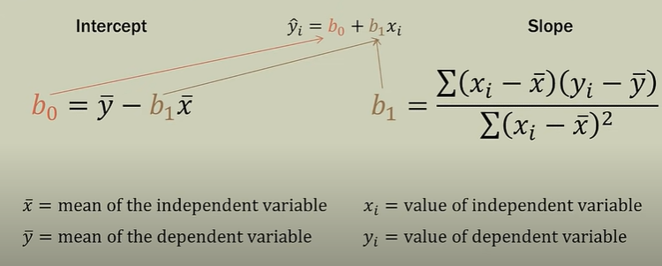
Step 4: Calculations

Slide 18
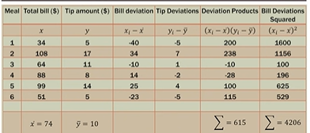
calculations

Slide 19
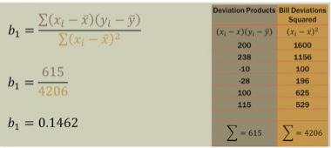
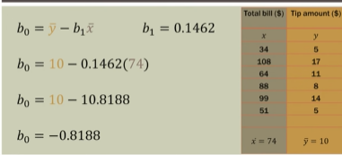

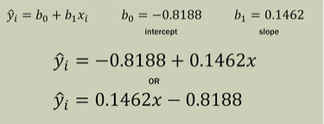
calculations

Slide 20
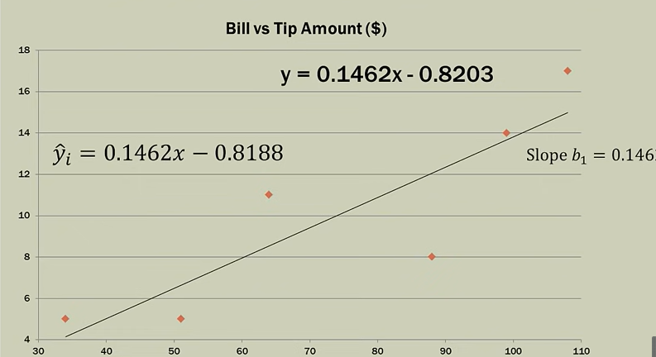
Regression line

Slide 21
Multiple Regression
Multiple regression is an extension of a simple regression
Simple regression : one to one
Multiple regression : many to one
Adding more independent variable to an multiple regression procedure does not mean the regression will be better or offer better prediction ; (OVERFITTING)
Adding more variance with new variable added
Dumping more variable is not the way to go the idea is to pick the best variable .

Slide 22
MULTICOLINEARITY
Adding more independent variable creates more relationship among them. So not only independent variables potentially related to dependent variable ,they are also potentially related to each other. This is called MULTICOLINEARITY .
The idea is for all of the independent variables to be correlated with the dependent variable but not with each other.
Because of Overfitting and multicollinearity , prep – work need to be done before doing multiple regression .

Slide 23
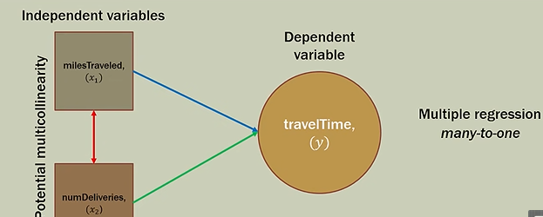
y = a + b _{1×1}+ b_{2×2}+……+ b_{kxk}
where x₁, x₂, ….x_{k} are the k independent variables and y is the dependent variable.

Slide 24
Multiple Regression
In multiple regression, each coefficient is interpreted as the estimated change in y corresponding to a one unit change in a variable, when all the other variable are held constant.

Slide 25
Multiple Regression Process
Generate list of dependent and independent variable
Collect data
Check relation ship between each independent and dependent variable using scatter plot and correlation
Check relation between independent variable using scatter plot and correlation
Optional
Conduct simple linear regression for each IV/DV pair

